Slide 1

Transforming Infection Prevention Control (IPC) Indicator Tracking with Innovative Spreadsheet Dashboards in Kenya
Ruth Thuku, Statistician, Aga Khan University Hospital, Nairobi
Ann Kamuyu, Research Associate , Aga Khan University Hospital, Nairobi

Slide 2
Introduction
The most challenging issue in monitoring and evaluation of IPC indicators in healthcare is the development of a systematic way of measurement and utilization of indicators for improvement. Development of such a system that incorporates variance reporting requires intensive effort and inclusion of each team member.
To address this, dashboards were developed to improve visibility and track trends in key performance data. This approach supports timely action and strengthens infection prevention and patient safety efforts across organization.
Notes:
The biggest challenge in monitoring IPC indicators is creating a clear system to measure and use them for improvement. Building such a system with variance reporting requires significant effort and teamwork.

Slide 3
Introduction
The introduction of an innovative spreadsheet-based dashboard for infection control indicators addresses these challenges by:
  Streamlining reporting into a single, automated platform, reducing delays and human-to-human dependency.
  Enhancing participation of unit-level staff in monitoring, through accessible and transparent dashboards.
  Centralizing data storage, ensuring uniformity, real-time updates, and integration with ICT infrastructure.
  Improving accessibility, enabling staff to track performance directly and foster evidence-based quality improvement.
  Strengthening data security through consistent backup and reduced reliance on fragmented files.

Slide 4
Literature Review
In the light of increasing healthcare costs throughout the developed countries, combined with an aging demographic and continuous technological advancement, innovation and its assessment gains importance not only in the literature but also in patient care (Proksch et al., 2019) who investigated if countries could be grouped by their innovation output in healthcare.
Health care administrators and policy-makers are faced with major questions regarding the allocation of scarce health care resources to select interventions that support high performance of health systems and increase the quality and efficiency of care and services (Hyppönen et al., 2016)
Substantial resources are invested in the health care system to improve the quality of care., However, evidence-based innovations in health care do not necessarily achieve their desired effects if they are affected by poor implementation quality. Therefore, it is important to differentiate between innovation and implementation effectiveness to measure implementation success innovation(Willmeroth et al., 2019).
Data quality challenges are also experienced when monitoring and evaluation systems compile information directly from Hospital Management Information Systems (HMIS) (Nshimyiryo et al. 2020). Emberti Gialloreti et al. (2020) concluded that multiple stakeholder involvement is necessary for a successful and timely system in the collection and monitoring of health information.
Notes:
Stakeholder involvement, innovation vs implementation, data quality challenges,

Slide 5
Justification
The importance of innovation in healthcare has increased within the last decades as challenges, like rising costs and an aging demographic, must be solved.
Healthcare adapting to systems faces constant challenges in adopting the latest technology to improve patient care especially in developing countries which are faced with scarce and limited resources.

Slide 6
Study Aim
To enhance efficiency of monitoring and evaluating infection prevention and control indicators using linked spreadsheets.
Notes:
To improve monitoring and evaluation of infection control indicators using linked spreadsheets

Slide 7
Method
To enhance visibility and tracking of IPC Key Performance Indicators (KPIs), Excel-based dashboards on Microsoft Share point were developed in-house due to the absence of suitable pre-existing tools. Each KPI was clearly defined with a numerator, denominator, and target or benchmark. Data collected from units is entered into daily/monthly data collection Excel sheets, which feed into unit dashboards.
These are further linked to form departmental and ultimately an institutional dashboard.
Traffic light color codes are used to visually represent monthly performance trends against targets. where red represents below target, amber indicates an improvement, green shows performance that met the target and purple shows inadequate samples.
The action plan tab consisted of a platform that aids in documenting corrective actions arising from the performance reviews.

Slide 8

Development of Dashboards
Key Performance Indicators are defined, numerator, denominator, and a target or Benchmark.
Create Daily/Monthly/ Quarterly Data entry sheets
Unit level
Link the Data tools with formulas to Unit dashboards
Link the Unit dashboards to Department Dashboards
Link the Department Dashboards
to Institutional Dashboards

Slide 9
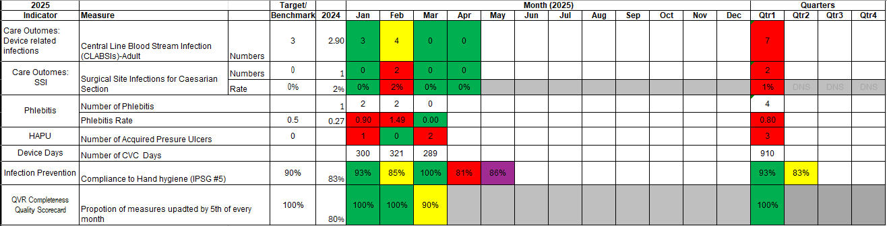
Dashboard and Colour codes configuration
Green – Target Met
Amber – Improvement from the previous year but below target/benchmark
Red - Target/benchmark not met
Purple- Sample Size not Met

Slide 10
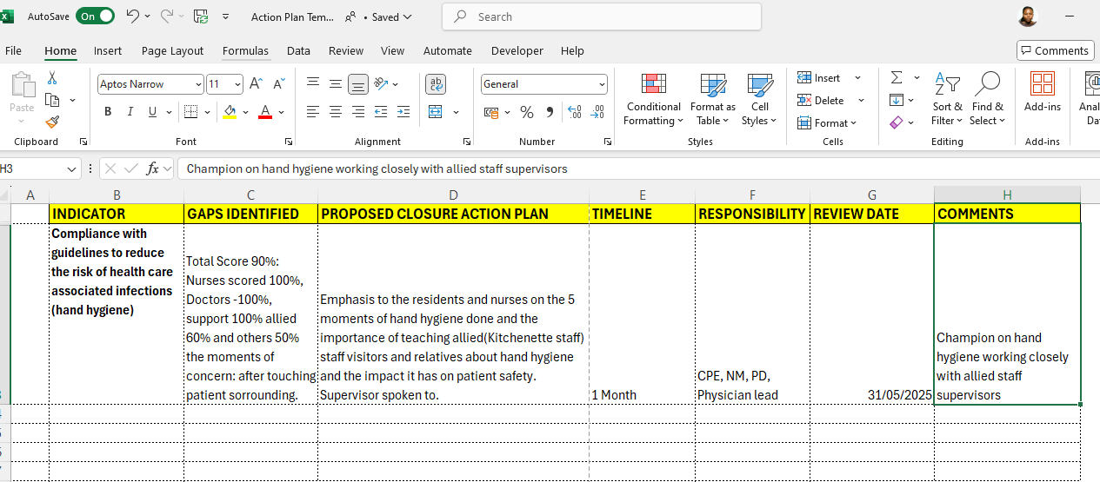
Action plan tab

Slide 11
Dashboard Turn around time monitoring
Dashboards are monitored monthly (by the 5th) to ensure timely data collection and entry, supporting effective results utilization.
Departments received monthly scores based on data availability across Infection Control Indicators.
Additional factors, such as developing and reviewing action plans, were also considered when determining the best performing department of the year.

Slide 12
Sustaining the Gains: Dashboard Efficiency in IPC Indicators Monitoring
Review of the trends in KPI performance you can narrow down on quality improvement (Q.I) projects.
The use of the Dashboards has enabled quicker discussion and shorter quality meetings regarding monitoring of indicators. This is because the agenda gets focused around the salient results on the dashboards. This improves efficiency and effectiveness in decision making.
Real-time data processing with built-in formulas and visualizations reduced time lags and eased Monitoring and Evaluation workload.
The Dashboards now assures a single and most up-to-date copy of data sheets and reports that are widely accessible to all users.

Slide 13
Data Protection and Back up
To strengthen data security, accessibility, and reliability, a structured framework was established for managing IPC indicators using spreadsheet-based dashboards. The ICT department implemented daily backups on separate hard disks and monthly offsite archiving to safeguard against data loss.
Access to the system was carefully controlled through rights management, password protection, and document-level controls, ensuring that only authorized users could view or update relevant files.
All users received basic training on Microsoft SharePoint, which served as the hosting platform. Access logs allowed monitoring of user activity, while document protection measures prevented unauthorized alteration of formulas and structures in the Dashboards.
Data are not entered directly into the Dashboards but are fed in through primary data entry sheets with enhanced data validation restrictions ensuring only the required type of data is entered .Dashboards were shared with departments on a read-only basis, promoting transparency while maintaining integrity.

Slide 14
Discussion
Impact of Dashboard Implementation on IPC
  Real-time access to KPI data at all levels (unit, departmental, institutional)
  Streamlined data entry and improved trend analysis
  Enhanced tracking of action plans for improvement
  Supported timely, data-driven decision-making
  Increased visibility of infection-related indicators → culture of performance measurement
  Sustained compliance with College of American Pathologist (CAP) & Joint Commission International (JCI) accreditation standards
  Improved infection prevention, quality of care, and patient safety

Slide 15
Recommendations
Linked Excel-based dashboards are a practical and effective tool for monitoring infection control indicators, especially in settings without advanced software.
They support timely tracking, data visibility, and continuous quality improvement in infection prevention efforts.

Slide 16
References
Gialloreti E, Leonardo FB, Basa SM, et al.:Supporting Iraqi Kurdistan Health Authorities in Post-conflict Recovery: The Development of a Health Monitoring System. Public Health Front. 2020
Hyppönen, H., Ronchi, E., & Adler-Milstein, J. (2016). Health care performance indicators for health information systems. Evidence-Based Health Informatics: Promoting Safety and Efficiency through Scientific Methods and Ethical Policy, 222(Mannerheimintie 166), 181–194. https://doi.org/10.3233/978-1-61499-635-4-181
Nshimyiryo A, Kirk CM, Sauer SM, et al.: Health management information system (HMIS) data verification: a case study in four districts in Rwanda. PLoS One. 2020; 15(7): e0235823
Proksch, D., Busch-Casler, J., Haberstroh, M. M., & Pinkwart, A. (2019). National health innovation systems: Clustering the OECD countries by innovative output in healthcare using a multi indicator approach. Research Policy, 48(1), 169–179. https://doi.org/10.1016/j.respol.2018.08.004
Willmeroth, T., Wesselborg, B., & Kuske, S. (2019). Implementation Outcomes and Indicators as a New Challenge in Health Services Research: A Systematic Scoping Review. Inquiry (United States), 56. https://doi.org/10.1177/0046958019861257

Slide 17
"You can have data without information, but you cannot have information without data."
– Daniel Keys Moran

Slide 18
THANK YOU

